Slide 1
Agreement on a good practice for describing Data Services / APIs
ISO & GeoDCAT-AP Pilot – 2nd Meeting Phase 2, 7 July 2026
Lena Hallin-Pihlatie (FI), Lars Storgaard (DK), Bianca Drepper (BE-Flanders), Jordi Escriu (JRC)

Slide 2
Goals
Agreement on a Good Practice for describing Data Services / APIs
Propose possible changes to the ISO to GeoDCAT-AP mapping behind SEMIC XSLT
Provide encoding examples in ISO (xml) and GeoDCAT-AP (rdf)
Perhaps:
Come up with a new, optional way to provide format information

Slide 3
Working procedure in short
Working Team T-1B meetings
26 February (kick-off meeting) and 27 March (core team)
Inventory and presentation of options
Which code lists and values are relevant for APIs/Services?
Workaround for the format of the distributions?
Sharing of material in a Teams channel created for the core team
Following steps (April-June)
By-weekly Teams-meetings
Analysed mandatory DCAT elements in relevant DCAT profiles
Provided example files to demonstrate the mapping for the Ds-Ser Linking Simpl. approach
Documented the mapping in Excel using a template found in the (draft)
Asked for feedback from core team members in JRC Teams repository
Workaround for formats -separate presentation by Belgium Flanders

Slide 4
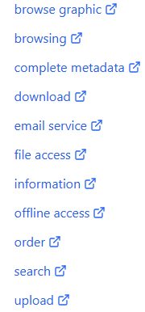
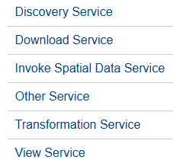
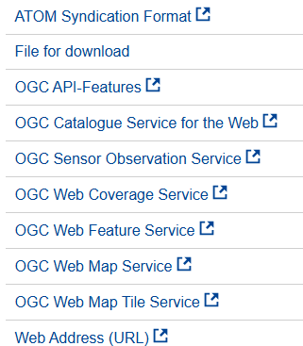
Options for SEMIC XSLT to map services/APIs
Present mapping
Use ISO 19115 Online function codes
https://defs.opengis.net/prez/catalogs/ogc-cat:hosted/col/defisotc211org:codesets/it1/codeset:OnLineFunctionCode
gmd:function
Use INSPIRE Spatial Data Service Type codes
https://inspire.ec.europa.eu/metadata-codelist/SpatialDataServiceType
gmd:applicationProfile or srv:serviceType
Use INSPIRE Protocol Value codes
https://inspire.ec.europa.eu/metadata-codelist/ProtocolValue
gmd:protocol
Use INSPIRE Spatial Data Service Category
https://inspire.ec.europa.eu/metadata-codelist/SpatialDataServiceCategory/
gmd:keyword
Use a combination of these

Slide 5
Spatial Data Service Category code list
https://inspire.ec.europa.eu/metadata-codelist/SpatialDataServiceCategory/
Atom-feed infoFeatureTypeService
WFS or OGC API Features infoFeatureAccessService
WCS infoCoverageAccessService
WMS or WMTS infoMapAccessService
And so on

Slide 6
Requirement of codes in INSPIRE metadata
Codes | INSPIRE dataset metadata (Ds-Ser Linking Simpl. approach) | INSPIRE service metadata (Classic Ds-Ser Linking approach) | INSPIRE dataset metadata (Classic Ds-Ser Linking approach) | Comments
Online function codes | Not required | Not required | Not required | TG Recommendation 3.4: metadata/2.0/rec/sds/resource-locator-additional-info
Spatial Data Service Type codes | Required | Required | Not required | TG Requirement 3.5: metadata/2.0/req/sds/sds-type
Protocol Value codes | Required | Not required | Not required | TG Requirement 3.4: metadata/2.0/req/sds/sds-category
Spatial Data Service Category | Not required | Required | Not required | TG Requirement 3.4: metadata/2.0/req/sds/sds-category

Slide 7
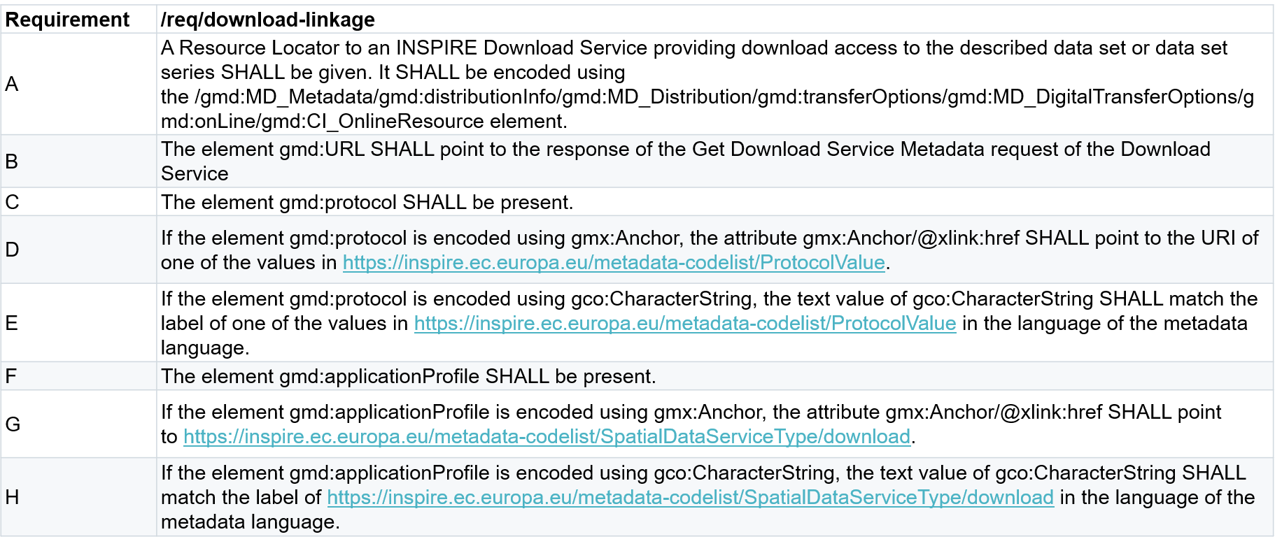
The Data-Service linkage approach for dataset metadata uses ProtocolValue and SpatialDataService

Slide 8
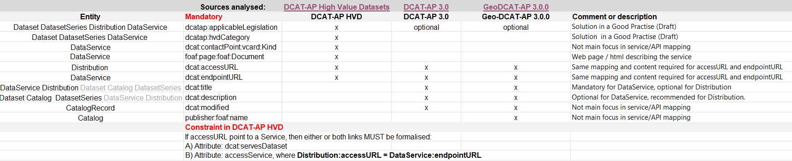
Focus: Mandatory elements
The analysis started identifying the mandatory elements to be provided for reporting HVDs, extracted from different relevant sources:
DCAT-AP 3.0
GeoDCAT-AP 3.0.0 (need to update to v3.1.0)
DCAT-AP for High Value Datasets
The proposed mapping has been scoped only to these mandatory items

Slide 9
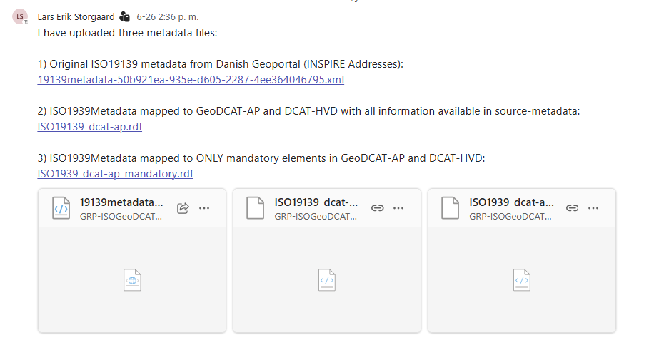
Example metadata encodings For datasets following Ds-Ser Linking Simpl. Approach
https://github.com/INSPIRE-MIF/GeoDCAT-AP-pilot/tree/main/meetings/2026-07-07/T-1B-data-services-apis/example-metadata-files
The example GeoDCAT-AP files passes SHACL validation, level 3

Slide 10
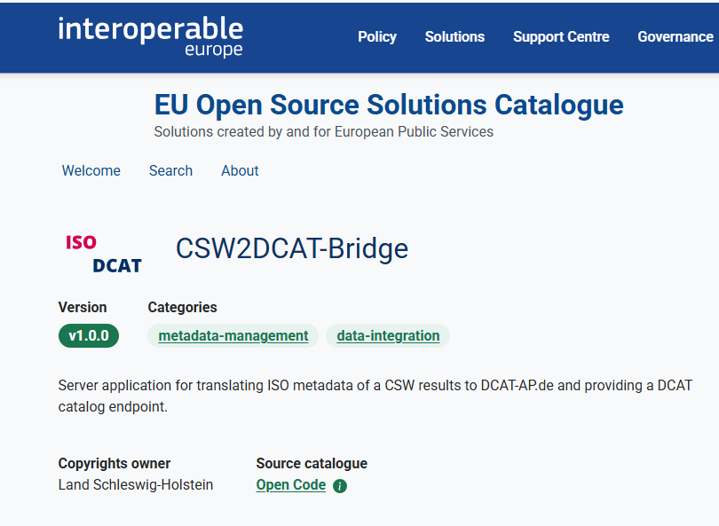
German CSW2DCAT Bridge
CSW2DCAT bridge found on the Interoperable Europe Portal
https://interoperable-europe.ec.europa.eu/eu-oss-catalogue/solutions/csw2dcat-bridge
German mapping to DCAT https://gitlab.opencode.de/sh/zit/opendata/csw2dcat

Slide 11
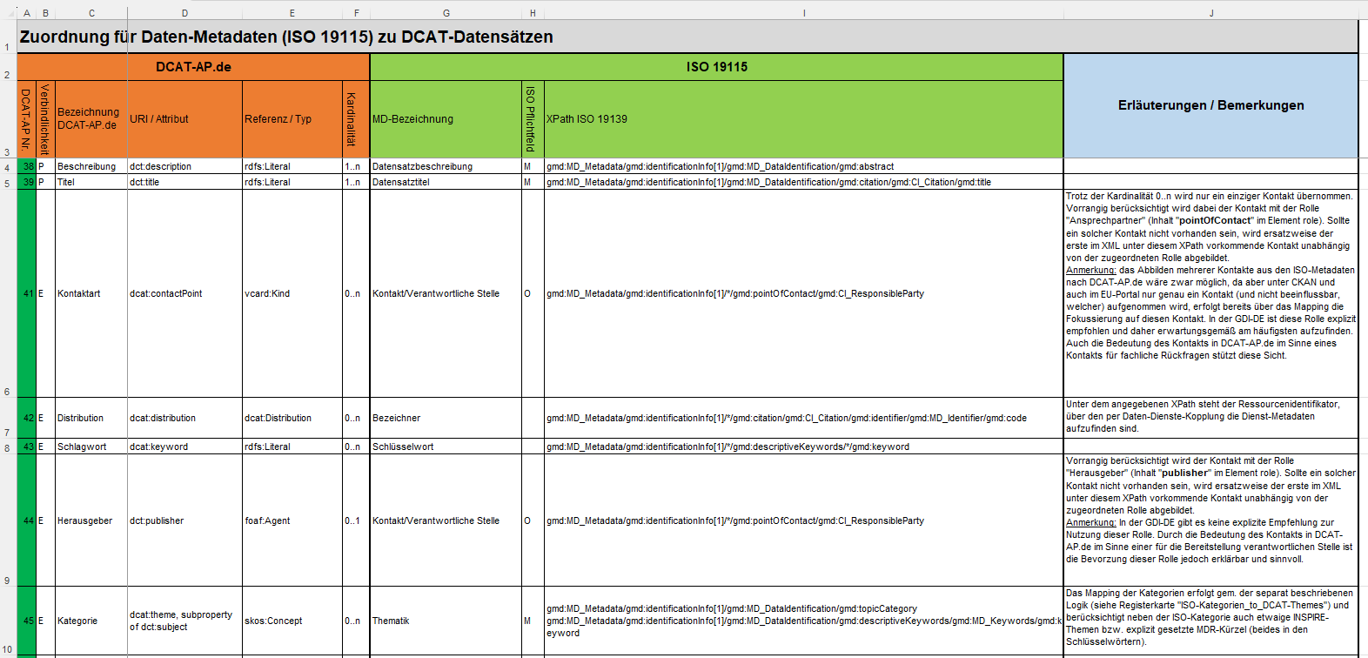
Inspiration to the Excel: Taken from the German mapping, reusing relevant parts

Slide 12
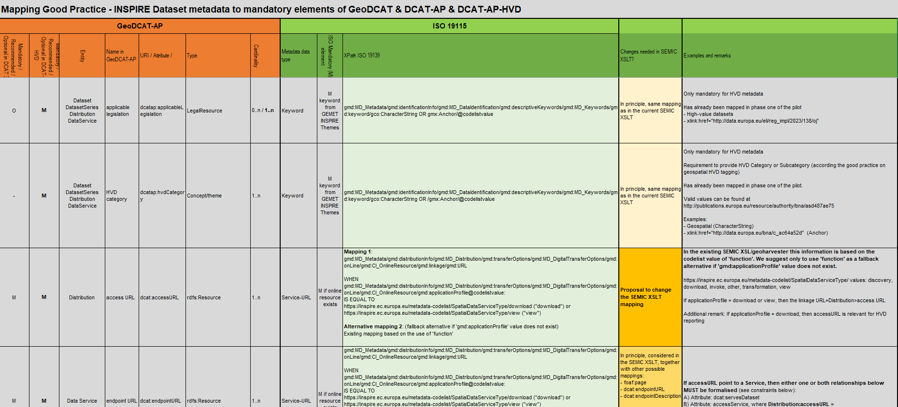
'GP Dataset metadata mapping' spreadsheet: Own mapping proposal based on Ds-Ser Linking Simpl approach

Slide 13
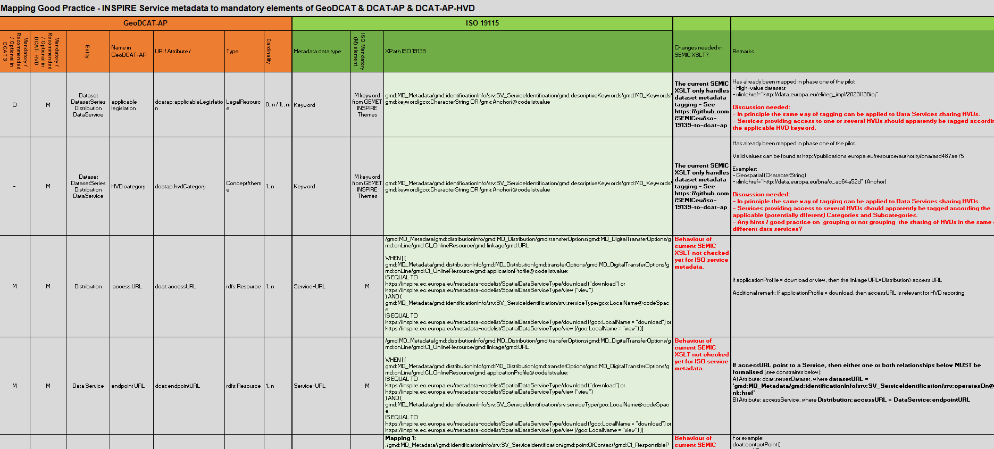
'GP Service metadata mapping' spreadsheet Own (draft) mapping proposal for service metadata

Slide 14
Materials for pilot participant’s feedback
Available at: https://github.com/INSPIRE-MIF/GeoDCAT-AP-pilot/tree/main/meetings/2026-07-07/T-1B-data-services-apis
Proposed mapping - focused only on mandatory elements to be provided for reporting HVDs: '20260707_Service-API_description_proposal.xlsx’
Example metadata encodings For datasets following the Ds-Ser Linking Simplification Approach / good practice
Original ISO19139 metadata from Danish Geoportal (INSPIRE Addresses): ‘19139metadata-50b921ea-935e-d605-2287-4ee364046795.xml’
ISO 19139 metadata mapped to GeoDCAT-AP and DCAT-HVD with all information available in source-metadata: ‘ISO19139_dcat-ap.rdf’
ISO 19139 metadata mapped to ONLY mandatory elements in GeoDCAT-AP and DCAT-HVD: ‘ISO1939_dcat-ap_mandatory.rdf’

Slide 15
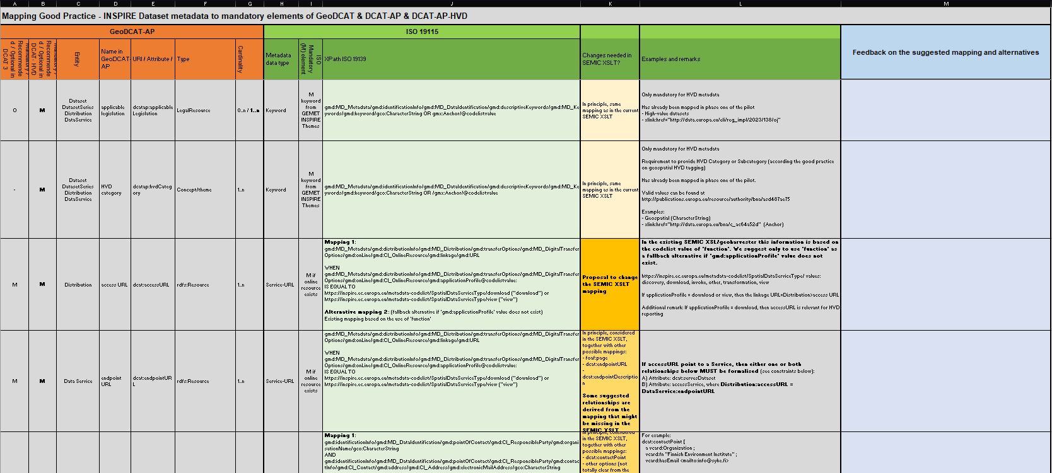
How to read / use the mapping spreadsheets
GeoDCAT-AP elements
ISO 19115 / 19119 Proposed mapping
Column for comments / feedback
YOUR INPUT IN THIS COLUMN

Slide 16
Next steps
Provide feedback on the proposed mapping and metadata encoding examples by 15th September 2026
Needed to guide the work done by T1-B so far
Kindly asking the Publications Office / EDP to analyse if the content of the draft encoding in the GeoDCAT-AP example is sufficient for HVD reporting
Using this post:
https://github.com/INSPIRE-MIF/GeoDCAT-AP-pilot/issues/15#issue-4826314143
First proposal for discussion – Pending aspects (work still ongoing)
Prepare encoding (ISO XML & GeoDCAT-AP) examples for service metadata
If needed, adding a selection of recommended dcat:elements to the examples, but preferably only a few – Provide feedback on which ones by 15 September
Refine changes proposed to the SEMIC XSLT
Refine the mapping (Excel file) if useful. Update to GeoDCAT-AP v3.1.0
Start drafting a good practice

Slide 17
Questions and remarks
Need to balance what is the most pragmatic approach for each metadata element
Keep existing behaviour / pattern of the current SEMIC XSLT, modifying the way data providers encode and fill in metadata records to make the transformation work.
vs.
Apply the specific changes proposed to the SEMIC XSLT, i.e. adapt this tool to existing metadata encoding practices from data providers.
May the SEMIC XSLT be altered so that it could take into account (in the code) if the starting point is either a dataset or a service metadata, and apply partly different mappings?
Proposed to replace ‘function’ as the main mapping criterion for linking to Services / API, using it still as a fallback alternative when the dataset metadata does not contain ‘gmd:applicationProfile’ – Possible approach?

Slide 18
Questions and remarks
‘foaf:page’
It is mandatory in the DCAT-AP HVD profile, but not in the other analysed ones.
Is this intentional? What should be mapped there versus ‘dcat:landingPage’, ideally?
‘foaf:page’ is not properly identified in geospatial ISO 19115 metadata
It would make sense to ask the community to produce new ‘foaf:page’ pages for their data services and encode their URLs using a weel-defined encoding.
‘servesDataset’ is pointing to an unresolvable URI (dataset identifier in dataset metadata) in the GeoDCAT-AP encoding example.
In Excel it has been mapped to the original dataset metadata. Preferences?
‘licence’ is not mandatory according to GeoDCAT-AP and DCAT-AP HVD data models (0..1) but mentioned in the HVD Reporting tool as a result and being speculated on in the DCAT-AP HVD guidelines.
Other aspects: To be discussed on top of the Excel file of the proposed mapping.

